Slide 1
CTA Introduction and Information Sharing
Focused for an audience of teachers and volunteers

Slide 2
Agenda
Mission
CTA History
Communications
Handling Students and Parents
Fun activities
Q&A
Overview of Teacher’s Training

Slide 3
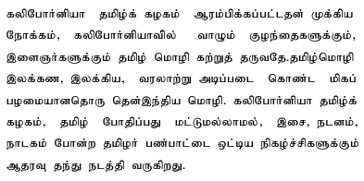
CTA’s Mission
Mission
California Tamil Academy (CTA) was conceived with the primary objective of teaching Tamil, an ancient South Indian Language with a very long history and rich literature to the children and young adults living in California. As an extension to the teaching of Tamil, CTA also sponsors cultural activities such as Music, Dance, Drama and any art form based on Tamil language and Tamil culture.

Slide 4
CTA’s Mission
CTA strives to provide "Commitment to Excellence" in teaching Tamil
Provide a kid friendly environment for students to learn Tamil for a minimum 10 to 12 consecutive years
Dedicated Staff
  Provide the best possible educational program in Tamil
  Provide an environment that motivates each child to learn and excel in the language

Slide 5
Class Structure
Classes
    Preschool two levels – I and II
    Basic Three Levels – 1, 2, and 3
    Grade 1 to 7
    proficiency classes
    Conversation Two Levels
    High School Credit Program
    Adult
Academic Year Schedule
First Term | Sep to Nov | 11 working days
Second Term | Dec to Feb | 11 working days
Third Term | March to May | 11 working days
Total Working Days - 33 (including Tests)
Holidays – 5
Quizzes / Tests - 3

Slide 6
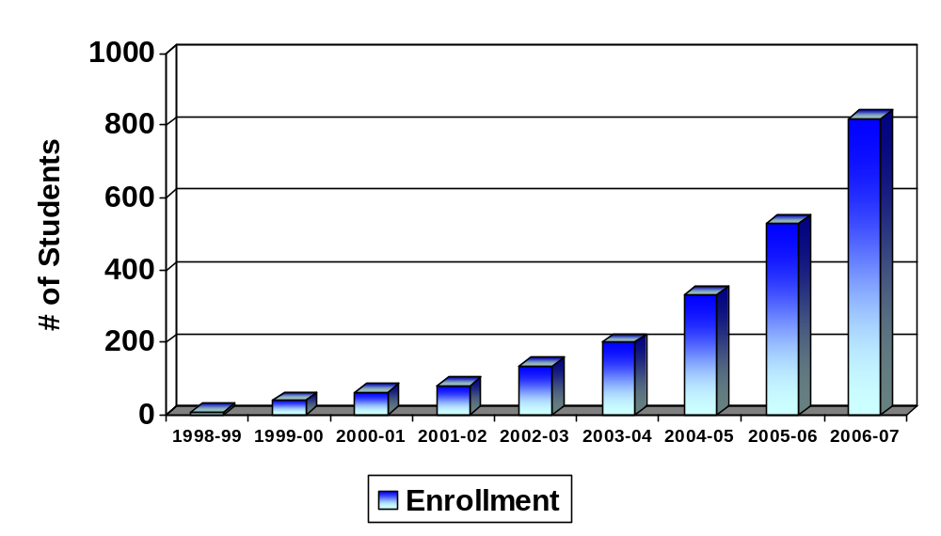
CTA’s Growth in 8 years

Slide 7
CTA’s History
CTA was conceived with the primary objective of teaching Tamil, an ancient South Indian language with a very long history and rich literature to the children and young adults growing up in California
Started as a home school with 13 students in the kitchen of an enthusiastic parent who wished to keep her children in touch with their Mother Tongue and cultural heritage.
Today’s Tamil School, California Tamil Academy was founded in 1998 with the help of 4 Parent Volunteer Teachers and has grown to a staff of 85 in 2005.

Slide 8
CTA’s Vision
Develop a love of learning Tamil that will last a lifetime (intellectual, physical and emotional)
Develop communication skills in Tamil so they can appreciate family values and feel the binding
Develop self-esteem and pride by participating in school / community activities
Provide an identity to our kids
Make the children to feel, internalize and self-convince about the value of Tamil – remove the question of why should I learn Tamil?

Slide 9
CTA’s Policies
Non-discriminatory Policy
CTA does not discriminate on age, gender, race, religion, physically handicapped or country
Well-defined, grade-appropriate syllabus & skills
Lower Teacher to student Ratio (from 8:1 to 10:1)
  Students are made to feel comfortable working at their proper pace
Trust & Care
  Work toward a feeling of personal value for each student, parent, and staff member.

Slide 10
Curriculum and Syllabus
Collaboration and feedback – the main sources of input to the committee
Teachers
Students
Testing
Committee
Syllabus
Committee

Slide 11
Curriculum and Syllabus
Constantly improving syllabus
  Composed through constant self evaluation
  Incorporate regular feedback from students, teachers, testing committee and parents
Teaching Materials
  Printed our own book sets (reading, writing and exercise) for preschool 1, 2, Basic 1, 2, and 3
  Currently use text books recognized by the Government of Tamil Nadu, India for Grade 1 to 7
  Other appropriate materials from various sources on the Internet
Curriculum is prepared with appropriate focus on reading, writing, and conversation

Slide 12
Communications
Weekly email from Principal to all parents
Weekly email from vice principal to all teachers
Email from class teachers to parents
  Preschool send every week
Yahoo groups for teachers to share and discuss
Website
Teachers and principal/vice principal are the touch points and main source of information for parents
You are representing the CTA. If you don’t know, direct to principal or board

Slide 13
Handling Students and Parents
NO punishment
Positive reinforcement
NO comparison with other kids
Address them with respect. Avoid saying vaadaa, podaa, Vaadi, Podi, etc
Understand and accept that there are many variations of Tamil. Don’t argue with parents about what is right Tamil.
Teach the formal Tamil set by CTA’s syllabus committee
Avoid arguments with parents. Let the principal and vice principal to handle the challenging situations
Be consistent
Be fair and friendly to kids and parents
Aim is to have the kid to come to school for many years
It’s NOT meant to be a competitive learning environment
It must be an enjoyable experience for students and parents. It’s a journey and NOT a race.

Slide 14
Fun activities
Halloween Parade
Deepavali
Thanks Giving
Christmas
Pongal
Tamil New Year
Graduation Ceremony
Annual Day

Slide 15
Q&A

